Slide 1

​ Session 37: Binary Semaphores (Locks), Counting Semaphores, algorithm semop
Operating Systems Design - 19CS2106R​
© 2020 KL University

Slide 2
Semaphore: A definition
An object with an integer value
We can manipulate with two routines; sem_wait() and sem_post().
Initialization
Declare a semaphore s and initialize it to the value 1
The second argument, 0, indicates that the semaphore is shared between threads in the same process.

Slide 3
Semaphore: Interact with semaphore
sem_wait()
If the value of the semaphore was one or higher when called sem_wait(), return right away.
It will cause the caller to suspend execution waiting for a subsequent post.
When negative, the value of the semaphore is equal to the number of waiting threads.
1 int sem_wait(sem_t *s) {
2 decrement the value of semaphore s by one
3 wait if value of semaphore s is negative
4 }

Slide 4
Semaphore: Interact with semaphore (Cont.)
sem_post()
Simply increments the value of the semaphore.
If there is a thread waiting to be woken, wakes one of them up.
1 int sem_post(sem_t *s) {
2 increment the value of semaphore s by one
3 if there are one or more threads waiting, wake one
4 }

Slide 5
Binary Semaphores (Locks)
What should X be?
The initial value should be 1.
1 sem_t m;
2 sem_init(&m, 0, X); // initialize semaphore to X; what should X be?
3
4 sem_wait(&m);
5 //critical section here
6 sem_post(&m);

Slide 6
Thread Trace: Single Thread Using A Semaphore
Value of Semaphore Thread 0 Thread 1
1
1 call sema_wait()
0 sem_wait() returns
0 (crit sect)
0 call sem_post()
1 sem_post() returns

Slide 7
Thread Trace: Two Threads Using A Semaphore
Value | Thread 0 | State | Thread 1 | State
1 |  | Running |  | Ready
1 | call sem_wait() | Running |  | Ready
0 | sem_wait() retruns | Running |  | Ready
0 | (crit set: begin) | Running |  | Ready
0 | Interrupt; Switch → T1 | Ready |  | Running
0 |  | Ready | call sem_wait() | Running
-1 |  | Ready | decrement sem | Running
-1 |  | Ready | (sem < 0)→sleep | sleeping
-1 |  | Running | Switch → T0 | sleeping
-1 | (crit sect: end) | Running |  | sleeping
-1 | call sem_post() | Running |  | sleeping
0 | increment sem | Running |  | sleeping
0 | wake(T1) | Running |  | Ready
0 | sem_post() returns | Running |  | Ready
0 | Interrupt; Switch → T1 | Ready |  | Running
0 |  | Ready | sem_wait() retruns | Running
0 |  | Ready | (crit sect) | Running
0 |  | Ready | call sem_post() | Running
1 |  | Ready | sem_post() returns | Running

Slide 8
Semaphores As Condition Variables
1 sem_t s;
2
3 void *
4 child(void *arg) {
5 printf("child\n");
6 sem_post(&s); // signal here: child is done
7 return NULL;
8 }
9
10 int
11 main(int argc, char *argv[]) {
12 sem_init(&s, 0, X); // what should X be?
13 printf("parent: begin\n");
14 pthread_t c;
15 pthread_create(c, NULL, child, NULL);
16 sem_wait(&s); // wait here for child
17 printf("parent: end\n");
18 return 0;
19 }
What should X be?
The value of semaphore should be set to is 0.
parent: begin
child
parent: end
A Parent Waiting For Its Child
The execution result

Slide 9
Thread Trace: Parent Waiting For Child (Case 1)
The parent call sem_wait() before the child has called sem_post().
Value | Parent | State | Child | State
0 | Create(Child) | Running | (Child exists; is runnable) | Ready
0 | call sem_wait() | Running |  | Ready
-1 | decrement sem | Running |  | Ready
-1 | (sem < 0)→sleep | sleeping |  | Ready
-1 | Switch→Child | sleeping | child runs | Running
-1 |  | sleeping | call sem_post() | Running
0 |  | sleeping | increment sem | Running
0 |  | Ready | wake(Parent) | Running
0 |  | Ready | sem_post() returns | Running
0 |  | Ready | Interrupt; Switch→Parent | Ready
0 | sem_wait() retruns | Running |  | Ready

Slide 10
Thread Trace: Parent Waiting For Child (Case 2)
The child runs to completion before the parent call - sem_wait().
Value | Parent | State | Child | State
0 | Create(Child) | Running | (Child exists; is runnable) | Ready
0 | Interrupt; switch→Child | Ready | child runs | Running
0 |  | Ready | call sem_post() | Running
1 |  | Ready | increment sem | Running
1 |  | Ready | wake(nobody) | Running
1 |  | Ready | sem_post() returns | Running
1 | parent runs | Running | Interrupt; Switch→Parent | Ready
1 | call sem_wait() | Running |  | Ready
0 | decrement sem | Running |  | Ready
0 | (sem<0)→awake | Running |  | Ready
0 | sem_wait() retruns | Running |  | Ready

Slide 11
How To Implement Semaphores
Build our own version of semaphores called Zemaphores
typedef struct __Zem_t {
int value;
pthread_cond_t cond;
pthread_mutex_t lock;
} Zem_t;
// only one thread can call this
void Zem_init(Zem_t *s, int value) {
s->value = value;
Cond_init(&s->cond);
Mutex_init(&s->lock);
}
void Zem_wait(Zem_t *s) {
Mutex_lock(&s->lock);
while (s->value <= 0)
Cond_wait(&s->cond, &s->lock);
s->value--;
Mutex_unlock(&s->lock);
}
…

Slide 12
How To Implement Semaphores (Cont.)
void Zem_post(Zem_t *s) {
Mutex_lock(&s->lock);
s->value++;
Cond_signal(&s->cond);
Mutex_unlock(&s->lock);
}
Zemaphore don’t maintain the invariant that the value of the semaphore.
The value never be lower than zero.
This behavior is easier to implement and matches the current Linux implementation.

Slide 13
Counting Semaphores
These are normally initialized to some value N, which indicates the number of resources (say buffers) available. We show examples of both binary semaphores and counting semaphores throughout the session.
We often differentiate between a binary semaphore and a counting semaphore, and we do so for our own edification. No difference exists between the two in the system code that implements a semaphore.

Slide 14
System V Semaphores
A semaphore is UNIX System V consists of the following elements:
The value of the semaphore.
The process ID of the last process to manipulate the semaphore.
The number of processes waiting for semaphore value to increase.
The number of processes waiting for the semaphore value to equal 0.
The system calls are:
semget to create and gain access to a set of semaphores.
semctl to do various control operations on the set.
semop to manipulate the values of semaphores.

Slide 15
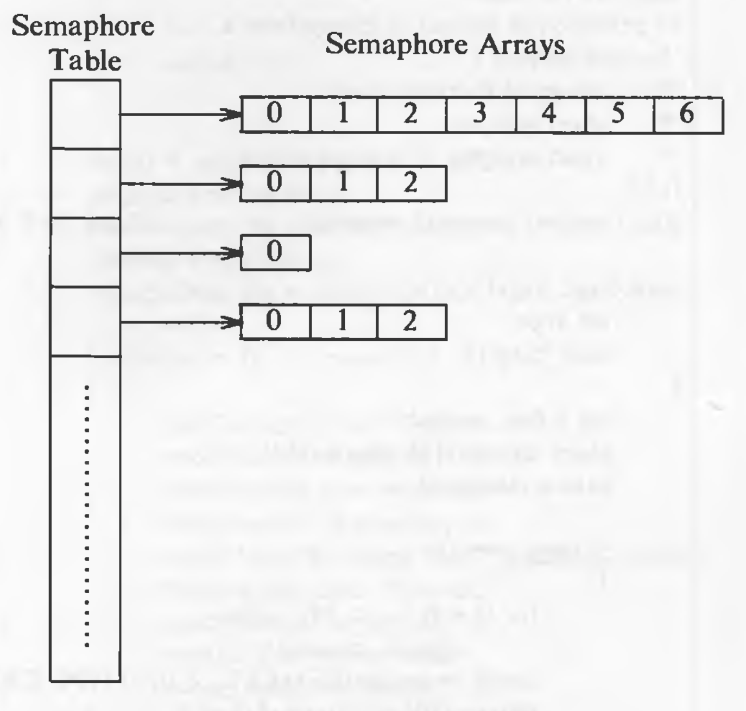
semget creates an array of semaphores: id = semget(key, count, flag); The kernel allocates an entry that points to an array of semaphore structure with count elements. It is shown in the figure:
The entry also specifies the number of semaphores in the array, the time of the last semop call, and the time of the last semctl call.

Slide 16
Processes manipulate semaphores with the semop system call:
oldval = semop(id, oplist, count);
where oplist is a pointer to an array of semaphore operations, and count is the size of the array. The return value, oldval, is the value of the last semaphore operated on in the set before the operation was done. The format of each element of oplist is,
The semaphore number identifying the semaphore array entry being operated on
The operation
Flags
The algorithm is given below:

Slide 17
The semop algorithm:
/* Algorithm: semop
* Input: semaphore descriptor
* array of semaphore operations
* number of elements in array
* Output: start value of last semaphore operated on
*/
{
check legality of semaphore descriptor;
start: read array of semaphore operations from user to kernel space;
check permissions for all semaphore operations;
for (each semaphore operation in array)
{
if (semaphore operation is positive)
{
add "operation" to semaphore value;
if (UNDO flag set on semaphore operation)
update process undo structure;
wakeup all processes sleeping (event: semaphore value increases);
}

Slide 18
The semop algorithm (cont.)
else if (semaphore operation is negative)
{
if ("operation" + semaphore value >= 0)
{
add "operation" to semaphore value;
if (UNDO flag set)
update process undo structure;
if (semaphore value 0)
wakeup all processes sleeping (event: semaphore value becomes 0);
continue;
}
reverse all semaphore operations already done
this system call (previous iterations);
if (flags specify not to sleep)
return with error;
sleep (event: semaphore value increases);
goto start;
}

Slide 19
The semop algorithm (cont.)
else // semaphore operation is zero
{
if (semaphore value non 0)
{
reverse all semaphore operations done this system call;
if (flags specify not to sleep)
return with error;
sleep (event: semaphore value == 0);
goto start;
}
}
}
// semaphore operations all succeeded
update time stamps, process ID's;
return value of last semaphore operated on before call succeeded;
}

Slide 20
The semop algorithm
If the kernel must sleep, it restores all the operations previously done and then sleeps until the event it is sleeping for, happens, and then it restarts the system call. The kernel stores the operations in a global array, it reads the array from user space again if it must restart the system call. That is how the operations are done atomically -- either all at once or not at all.
Whenever a process sleeps in the middle of a semaphore operation, it sleeps at an interruptible priority. If a process exits without resetting the semaphore value, a dangerous situation could occur. To avoid this, a process can set the SEM_UNDO flag in the semop call. If this flag is set, the kernel reverses the effect of every semaphore operation the process had done. The kernel maintains a table with one entry for every process in the system. Each entry points to a set of undo structures, one for each semaphore used by the process. Each undo structure is an array of triples consisting of a semaphore ID, a semaphore number in the set identified by ID, and an adjustment value. The kernel allocates undo structure dynamically when a process executes its first semop system call with the SEM_UNDO flag set.

Slide 21
Syntax of semctl:
semctl(id, number, cmd, arg);
where arg is declared as a union:
union semunion {
int val;
struct semid_ds *semstat;
unsigned short *array;
} arg;
where kernel interprets arg based on the value of cmd, similar to the way it interprets the ioctl command.

Slide 22
Thank you

